Slide 1
Kubernetes
Notes:
1

Slide 2
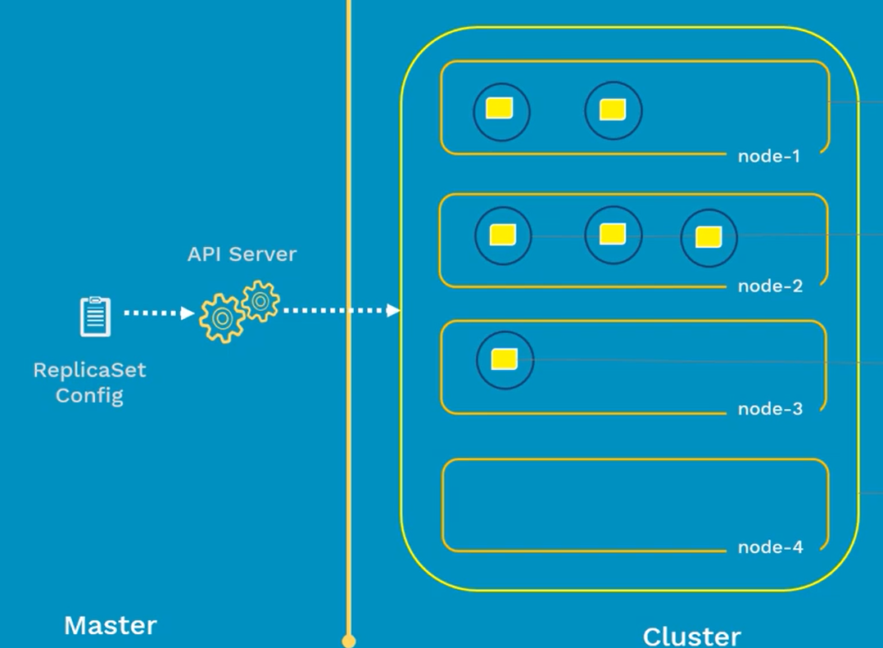
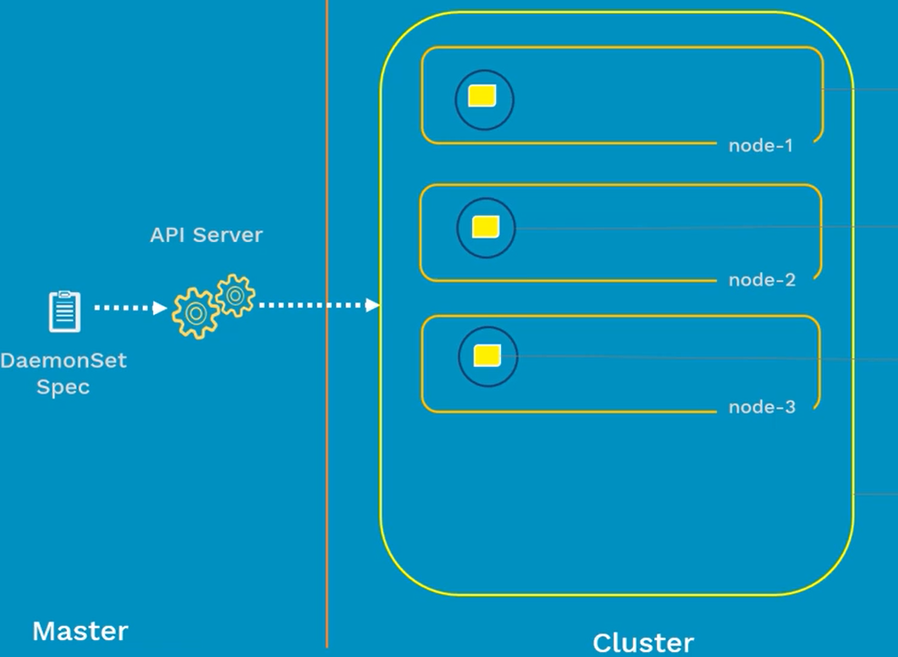
DaemonSet
Restrict the number of POD instance to 1 in a node
POD instance should run on all nodes
When new nodes are added to cluster, Daemonset ensure PODs are created on those nodes also

Slide 3
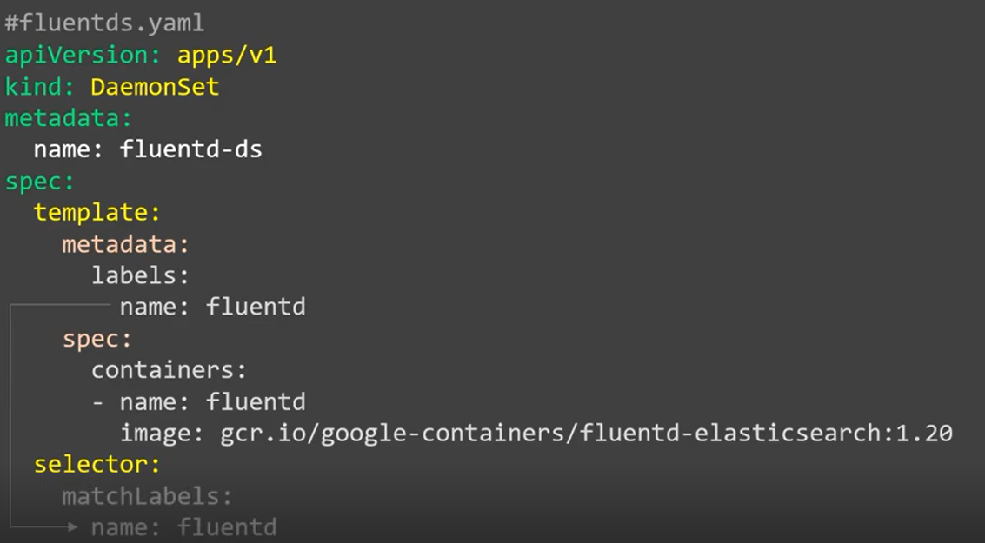
DaemonSet
Some typical uses of a DaemonSet are:
Running a cluster storage daemon on every node
Running a logs collection daemon on every node
Running a node monitoring daemon on every node

Slide 4
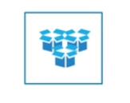
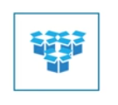



Service
Abstraction that defines a logical set of pods and a policy for accessing the pod set.
A service is assigned an IP address (“cluster IP”), which the service proxies use.
A label selector can find pods that are targeted by a service.

Slide 5
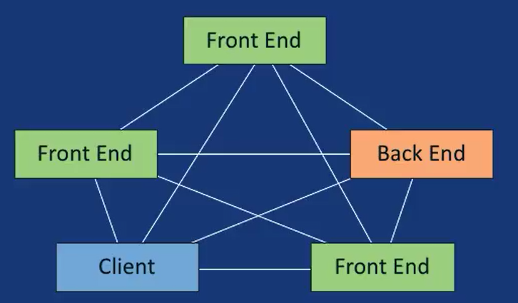
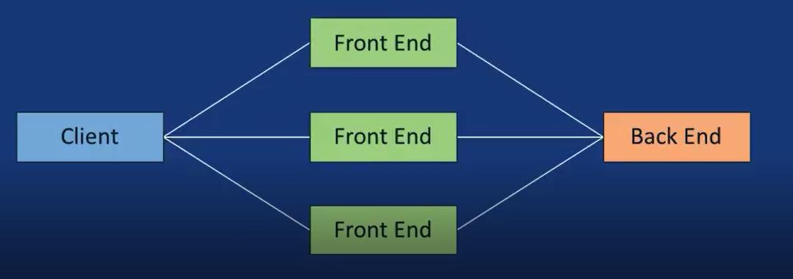
Service
Default Behavior
Desired Behavior

Slide 6
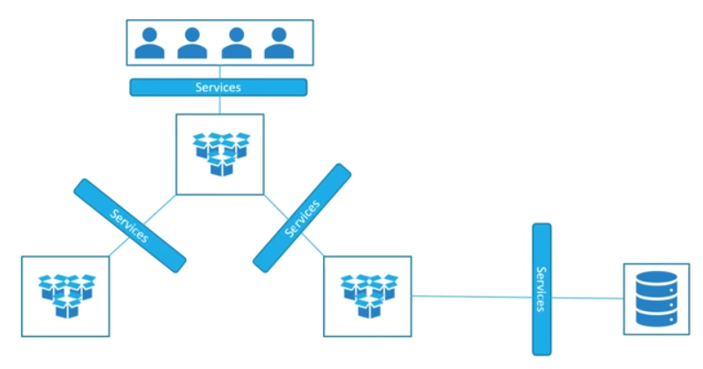
Types of services
ClusterIP exposes the cluster's internal IP.
NodePort exposes the Service on each node's IP at a static port.
LoadBalancer exposes the Service externally

Slide 7
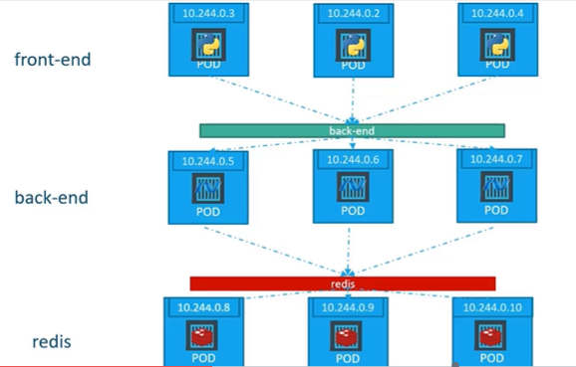
ClusterIP
It is a service inside your cluster that other apps inside your cluster can access.
Access to POD through ClusterIP service is only available within the cluster

Slide 8
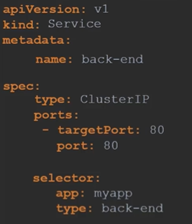
ClusterIP
This is the default ServiceType.
Service can map an incoming port to any targetPort.

Slide 9
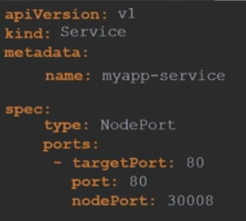

NodePort
NodePort exposes the Service on each node's IP at a static port.
Along with NodePort service, it also creates a ClusterIP Service, to which the NodePort Service routes

Slide 10
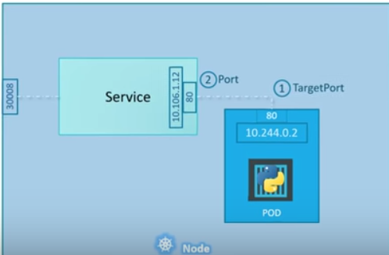

NodePort
Enable us to access the NodePort Service, from outside the cluster, by requesting <NodeIP>:<NodePort>

Slide 11
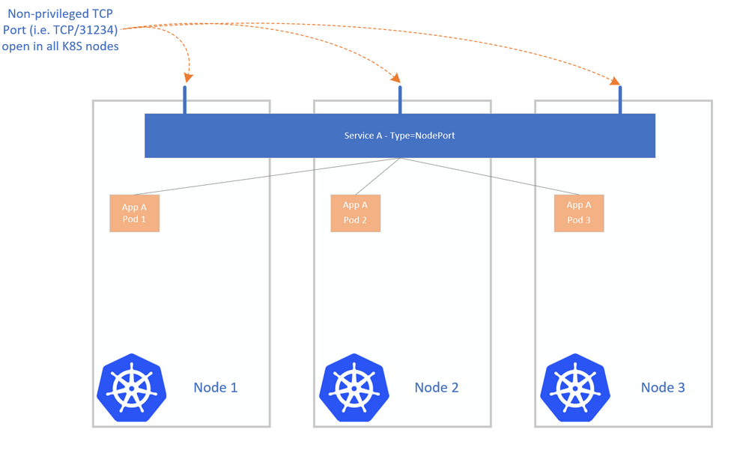
NodePort

Slide 12
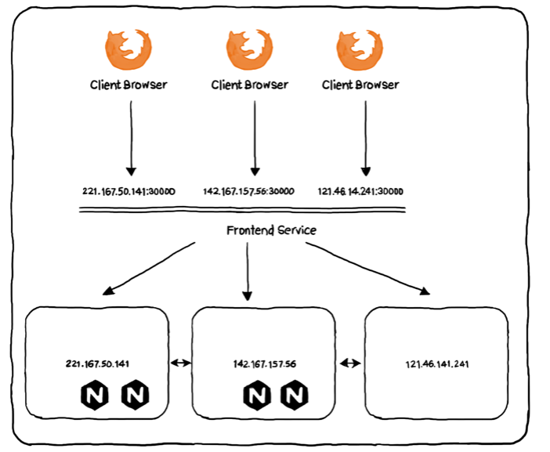
NodePort - Limitations
Connecting to NodePort service is through one of the Node IP in the cluster. This could potentially expose the Nodes vulnerable to attack from malicious users.
NodePort allows port within 30000-32767 range. Firewalls may restrict access due to security reasons

Slide 13
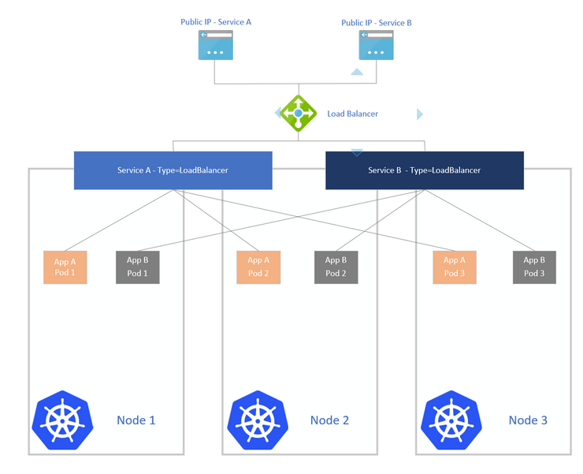
LoadBalancer

Slide 14
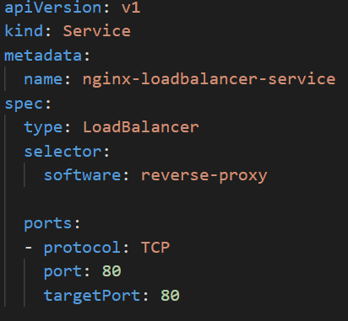
Loadbalancer
Why LoadBalancer :
Clients should not connect to a working IP.
A connecting IP can become inaccessible.

Slide 15
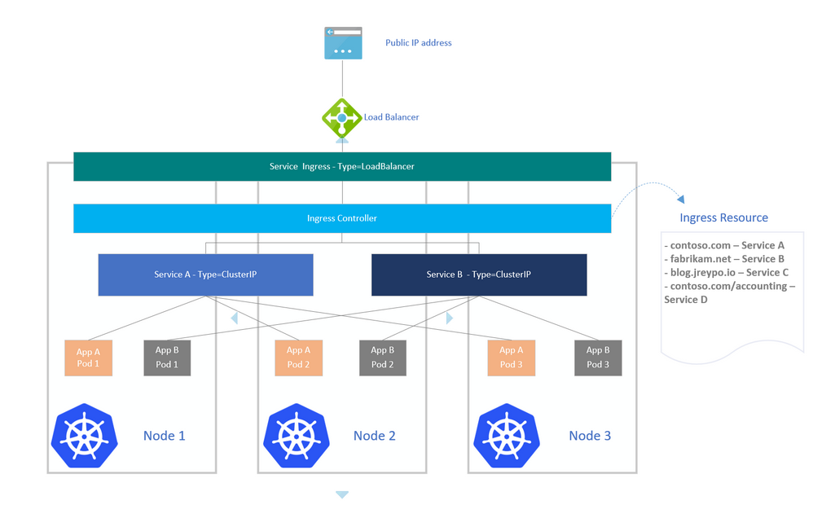
Ingress

